Slide 2
INTRODUCTION of the presentation
This presentation elaborates about the audit of the Music Partnership North's current strategies.
The presentation further elaborates about the current strategies related to the marketing mix of the organization. Moreover it also shows the perpetual map which shows the quality and the competitors.
Lastly the presentation shows the conclusion of all the current marketing strategies.
Notes:
This slide states that the current strategies related to the marketing mix of the organization. It certainly shows the conclusion of all the current marketing strategies. Moreover the presentation is based upon the Music Partnership North.

Slide 3
Overview of the company
The Music Partnership North has more than 122 hubs in England and has helps the children to enhance the education related to music.
This organization is certainly serves young people and children in area and teaches them about the importance of the music.
It enhances the participation of the individuals through quality music and it is for Newcastle and Northumberland.
Notes:
This slide shows about the company as the company has 122 hubs in England and has helps the children to enhance the education related to music. The company also provides quality services and enhances the participation of the individuals.

Slide 4
Team of Music Partnership North
Notes:
This slide shows the members of the team as who handles the company which are Jennifer Deborah, Jack William abd Tom Benedict.

Slide 5
CURRENT MARKETING STRATEGY
There are certain ways by which the music school does marketing is done by the exposure of the result from the cooperation provided by the council of Newcastle city council (Music Partnership North- Newcastle, 2021).
This certainly contains and owns the services of music with the help of social media accounts and internet website that increases the students that want to learn music.
But these websites and social media accounts are not very effectively updated and used on frequent basis.
Notes:
The slide represents marketing strategy that shows that the company has does marketing of the services of music with the help of social media accounts and internet websites and also with the help of exposure of the result from the cooperation.

Slide 6
Business by different social media accounts
Notes:
This slide shows the that which social media platform promotes how much business.

Slide 7
MARKETING MIX
Marketing mix consists of different factors that affect the marketing of the product.
Where the organization serves and in what amount the organization is serving affect the marketing of the organization and as per analysis it consists of several lectures it provides the music lectures in different forms that attract more number of consumers.
Moreover there are many factors that have influenced the effects of the organization like Brexit, economic aspects and much more.
Notes:
This slide shows the concept of marekting mix which shows that the company does marketing of the organization and through several lectures it provides the music lectures in different forms. Many factors affect the marketing of the company that are Brexit, economic aspects and more.

Slide 8
MARKETING MIX – PRODUCT
The organization provides number of music offers and music tuitions to the children and young individuals.
The services it serves are music classes in the different groups like individual groups, small groups, whole class ensemble tuition and deliveries of wide range of music.
The organization has a good personalisation of the size of the courses and its time as per the consumer, contains great variety of the music and consists of many music instruments (Hebert, 2017).
Notes:
This slide shows the product aspect of the business that elaborates organization has a good personalisation of the size of the courses and its time as per the consumer and also offers music tuitions to the children and young individuals.

Slide 9
MARKETING MIX – PRICE
There is difference in the prices of the services as it differentiates as per the for one class the organization offers £108 for two classes £162 and for three classes or more £180.
It also customizes the operations of the workshop that focuses upon the cost as £468 for the full day.
It also offers certain offers and discounts that that invites both customers as well as the teachers (MPN Music Hub, 2021).
Notes:
This slide shows the price aspect of the business that shows the organization offers £108 for two classes £162 and for three classes or more £180 and also customizes the operations of cost as £468 for each day.

Slide 10
MARKETING MIX – PLACE
As there are many hubs of Music Partnership North in England. There are certain hubs in respect to Newcastle services.
There are some main hubs and centres that are mostly focused that are Partnership North (MPN) Music Education Hub and Arts Council England (ACE)
Certain hubs provide quality services and music classes and they work with the help of many local organization (Music Partnership North, 2021).
Notes:
This slide shows the place aspect of the business that shows the main hubs are Partnership North (MPN) Music Education Hub and Arts Council England (ACE) and they provide quality services and music classes by local organizations.

Slide 11
MARKETING MIX – PROMOTION
The organization promotes itself by increasing the innovation in its services as well as contain variety of services.
It facilitates the connections with the help of facilitating the transactions with the help of third parties and provides the accessible substitutes and increases the consumers by providing more number of cheaper services.
With the help of different online websites and social media sites (Meier, 2017).
Notes:
This slide shows the promotion aspect of the business as the comopany is seen to be facilitating the connections with the help of facilitating the transactions with the help of third parties and provides the accessible substitutes.

Slide 12
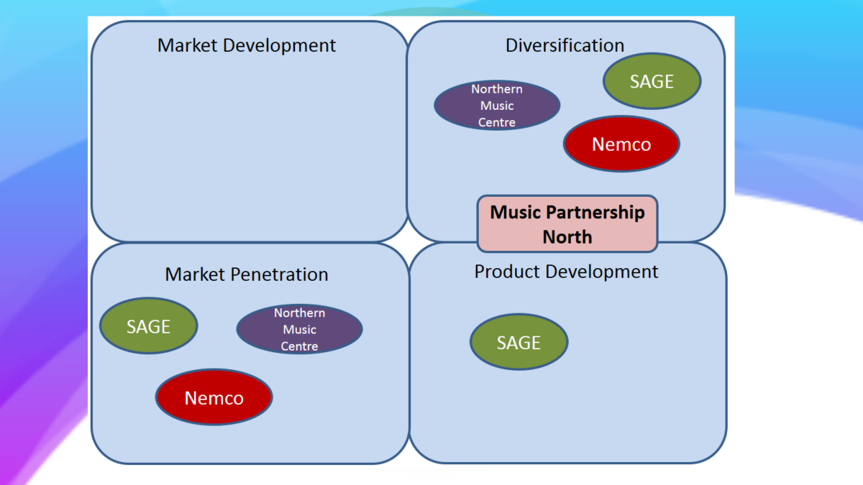
PERPECTUAL MAP
Notes:
This slide shows perpetual map of the organization Music Partnership North.

Slide 13
PERPECTUAL MAP- QUALITY and competitors
There are different competitors of this organization but there are majorly two that are SAGE and NEMCO.
These both provide the services related to classic music instruments that are highly differentiated.
SAGE is considered best in market and the costs are higher than Newcastle (Charanga Musical School , 2021).
Notes:
This slide shows the competitors of this organization but there are majorly two that are SAGE and NEMCO. It is visible that SAGE is considered best in market. All the functions of the companies are differentiated highly.

Slide 14
EXPLANATION OF THE PERPECTUAL MAP
As the perceptual map represents in which aspect the competitors of the music partnership north are successful and what are the phases in which they need to grow.
The main competitors are visible as SAGE and Nemco as they are have successful diversification and penetration strategies which certainly elevates them up from music partnership north .
Moreover the costs of the companies are high in respect to the music partnership north as they are more popular and have their presence on social media.
Notes:
This slide represents the explanation of the conceptual map as it explains the competitors of the music partnership north are successful and what are the phases in which they need to grow and the costs of the companies are high in respect to the music partnership north’.

Slide 15
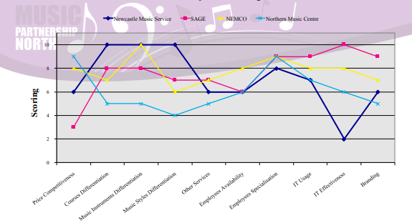
COMPETITOR ANALYSIS
Notes:
This slide shows the competitor analysis of the organization.

Slide 16
Conclusion of the marketing strategies
Overall conclusion of this presentation and the strategies of this organization is to provide quality services and music classes and they work with the help of many local organization.
01
As the organization consists a huge range of musical instruments that ae available and are made available for the particular tuitions.
02
The organization promotes itself different online websites and social media sites Ryan, 2016).
03
Notes:
This slide shows the marketing strategies that are to provide quality services and music classes and they work with the help of many local organization and this is done with the help of online websites and social media sites.

Slide 17
references
Charanga Musical School , 2021, The award-winning, modern-day resource for primary music. [Online] Available at: https://www.musicpartnershipnorth.co.uk/site/ [Accessed 21st October 2021]
Music Partnership North- Newcastle, 2021, Curriculum Support Resources: Spring. [Online] Available at: https://www.musicpartnershipnorthnewcastle.co.uk/website [Accessed 21st October 2021].
MPN Music Hub, 2021, MPN Music Hub @MPNEHub. [Online] Available at: https://twitter.com/MPNEHub?ref_src=twsrc%5Egoogle%7Ctwcamp%5Eserp%7Ctwgr%5Eauthor[Accessed 21st October 2021].
Music Partnership North, 2021, Music Partnership North is committed to enriching the lives of children and young people in Northumberland & Newcastle through engagement and participation in quality music activities" . [Online] Available at: https://www.northumberland.gov.uk/Education/Music-Service.aspx [Accessed 21st October 2021].

Slide 18
References
Music Partnership North - Newcastle, 2021, Music Partnership North Newcastle". [Online] Available at: https://www.servicestoschools.org.uk/Services/148 [Accessed 21st October 2021].
Ryan, D., 2016. Understanding digital marketing: marketing strategies for engaging the digital generation. Kogan Page Publishers. https://books.google.co.in/books?hl=en&lr=&id=4pZlDQAAQBAJ&oi=fnd&pg=PR5&dq=music+partnership+north+marketing+strategies&ots=Pb2XvH_Par&sig=xR2h4optB2HQUogOZz2YQgwF2uc&redir_esc=y#v=onepage&q&f=false
Meier, L.M., 2017. Popular music as promotion: Music and branding in the digital age. John Wiley & Sons. https://books.google.co.in/books?hl=en&lr=&id=DWdNDwAAQBAJ&oi=fnd&pg=PP1&dq=music+partnership+north+marketing+strategies&ots=L_4Qc_r-sa&sig=5yjYH-SauTdE5PHEylV5bT3oFQw&redir_esc=y#v=onepage&q&f=false
Hebert, D.G., 2017. Ethnicity and music education: Sociological dimensions. In Sociology and music education (pp. 115-136). Routledge. https://www.taylorfrancis.com/chapters/edit/10.4324/9781315087856-18/ethnicity-music-education-sociological-dimensions-david-hebert

